Slide 1


Slide 2
SafeSendLinea
Konstantinos Andreou
A Smart Contract on Linea Sepolia network, which aims to prevents loosing funds, from miss-typed wallet address.
Chainanalysis estimates more than $3.8 billion of crypto was lost last year alone.

Slide 3

Relief from Stress – Use SafeSendLinea
Most people say that they feel stress when sending big amounts throught crypto. Since if any error or misstyped address, can lead to lost of funds. What if there is a dApp to relief from this Stress? Get back your crypto if the receiver doesn’t claim it!

Slide 4
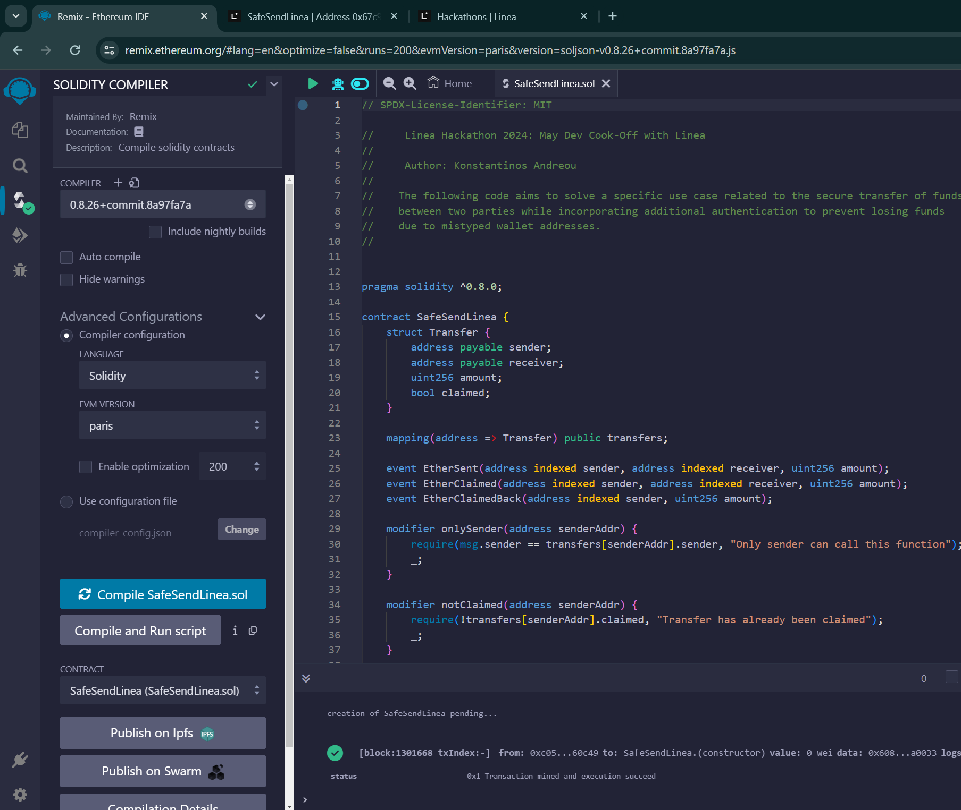
SafeSendLinea

Slide 5
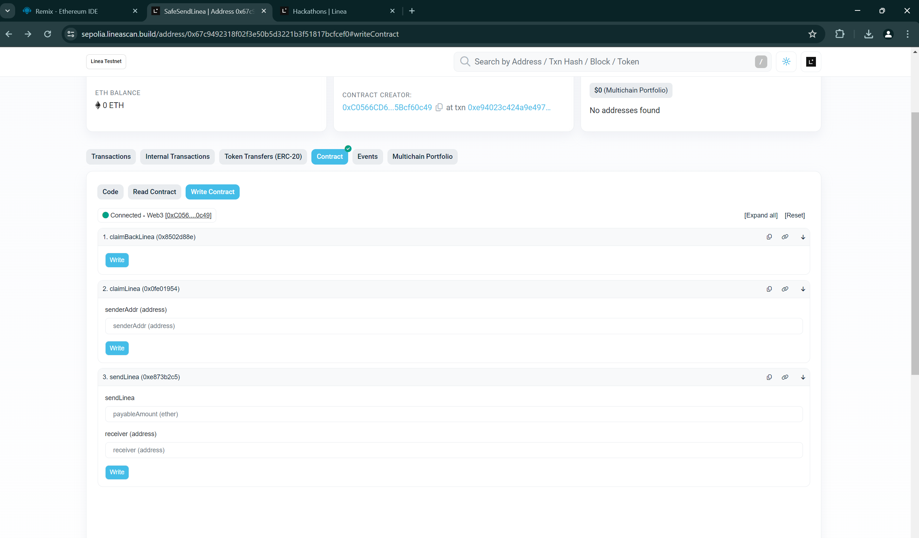
3 Simple Transactions

Slide 6

Thanks for your attention

